Slide 1
Dataception 😎
RED HEADER – ADDITIONS NEEDED
BLUE HEADER – DONE BUT REVIEW NEEDED
Investigating the Varying Qualities of Data Science Jobs
Andy De La Fuente
Matthew Rhodes
Juan Solorio
Anmol Srivastava

Slide 2
Industry Experiences Can Inform Prospective Data Scientists
Exploring high-volume data related to data science positions around the world enables us to:
Identify factors that significantly affect benefits
Distinguish between the common skills and tools used in different roles

Slide 3
Suitable Data Available Via Kaggle
Kaggle hosted an industry-wide survey to collect data regarding:
The career and academic backgrounds of current data scientists
In-demand skills and tools for data science employees
Real-world advice and compensation comparisons from workers
Data points were both free-response and multiple choice
The UN / World Bank Group’s 2019 ‘Population Prospects’ also offer:
Summary data regarding global population densities in major cities

Slide 4

Data Is Robust But Issue-Prone
Valuable features include:
Salary
Recommended programming languages
Job location
Employee level of education
Several attributes hinder analysis, however:
Several features are sparsely populated and missing data
Salaries vs. commissioned compensation
Free-response answers are hard to incorporate

Slide 5



Data Is Robust But Issue-Prone
Some initial data-cleaning steps were prudent:
Initial dimensions 16k x 228
New dimensions after filtering 16k x 21
Removed NA values
Only considered multiple choice responses
Removed 0s from Compensation to only analyze people who are employed
Split Compensation into Salary and Commission

Slide 6
Questions Focus On Pay & Job Attributes
Compensation is a useful metric for asking:
Is a data scientist’s pay affected by their physical job location? In particular, do employees in high-density environments (like urban cities) see different pay than those in sparsely-populated areas?
What is the relationship between a data scientist’s income and the tools they use on the job? Specifically, do the programming languages they indicate as ‘valuable’ reflect the level of their salary or commission?
Does education level play a significant role in compensation? How so? What differences in pay do we see among differently-accoladed employees?

Slide 7
Arriving at Suitable Analyses
Methods for Q1: ANOVA, Linear Regression, and Welch T.Test
Unequal variance
Columns: CompensationYearUSD, Density
All data points are independent
Method for Q2: ANOVA and Linear Regression
Datasets seem to be close enough in variance
Belief of linear relation with “higher” position (need for more math theory)
Method for Q3 (_ vs. _)
Why appropriate
Brief review of method (brieeeeef)
Data Columns Involved (+ any additional data wrangling steps)
Assumptions for test

Slide 8
Arriving at Suitable Analyses
Power calculations
Given the sample sizes of the various groups we calculated the following power for each test.
Pay vs Population density at least .97
Pay vs Programming language at least
Pay vs Education at least

Slide 9
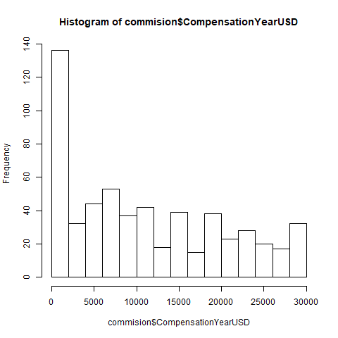
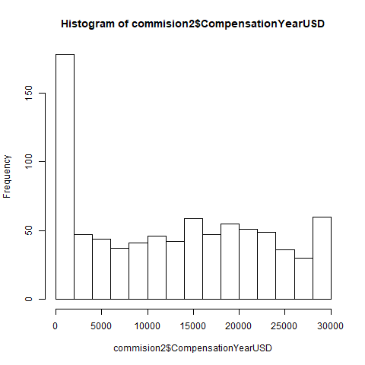
Visualizing Findings for Q1
High Density Low Density
commission commission
P value:
2.765e-5
Null: There is no difference in the mean commission between for high and low density.

Slide 10
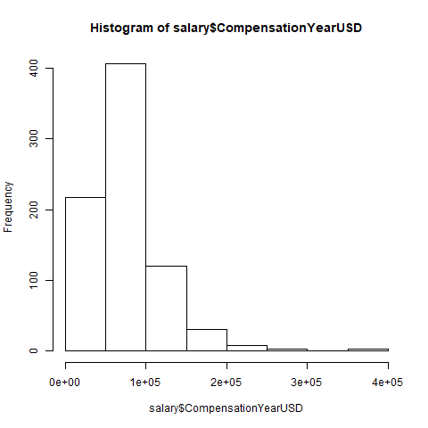
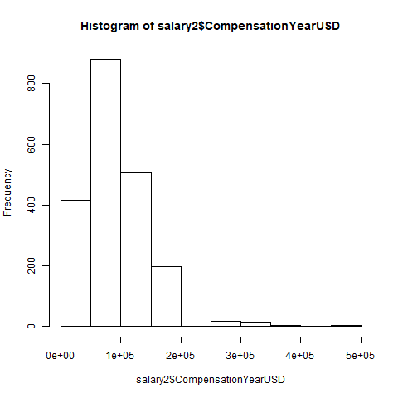
Visualizing Findings for Q1
P value:
2.2e-16
Null: There is no difference in the mean salary between for high and low density.
High Density Low Density
Salary Salary

Slide 11
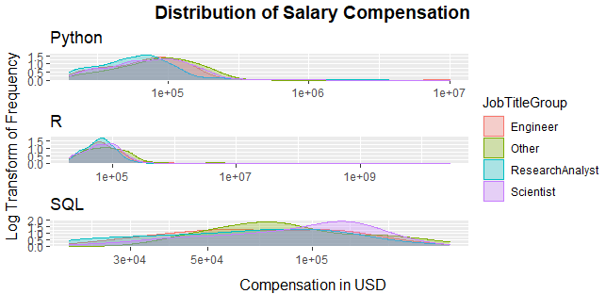
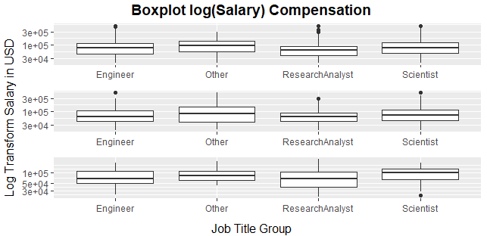
Visualizing Findings for [Q2]

Slide 12
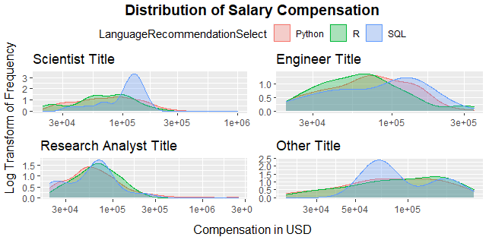
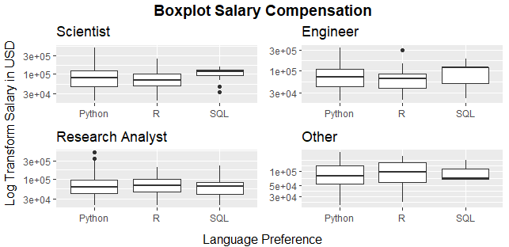
Visualizing Findings for [Q2]

Slide 13
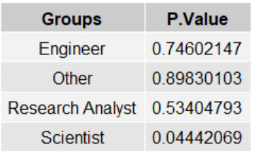
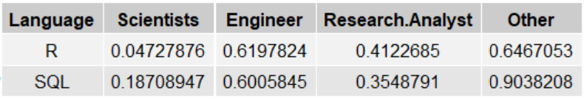
Visualizing Findings for [Q2]
In ANOVA test for each individual Job title group, only the Scientist shows enough evidence to reject the null hypothesis of no difference between type of recommended programming language
In the Linear Regression model, only the Scientist group shows evidence of a linear relation between the mean change in salary for python and R programming language.

Slide 14
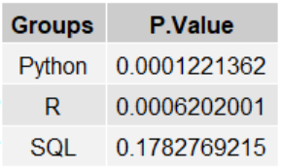
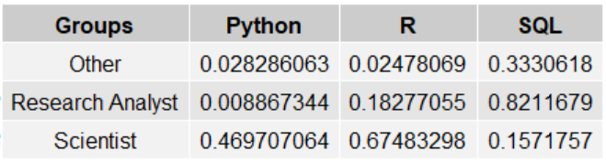
Visualizing Findings for [Q2]
In ANOVA test for each individual Recommended Programming Language groups, only the Python and R shows enough evidence to reject the null hypothesis of no difference between type of Job Title.
In the Linear Regression model, Python group shows evidence of a linear relation between the mean change in salary for Job Titles Other and Research Analyst to the Engineer Title. R shows a statistically significant linear relation between the change in mean of salary between the Engineering and Other Job Titles.

Slide 15
Results, Formalized and Interpreted
Based on the results we can conclude that there is a statistically significant difference between the mean compensation of people that live in densely populated areas vs. sparsely populated areas. (For both densely and non-densely populated areas)

Slide 16
Several Limitations Affect These Analyses
Variances were not equal
The size of the dataset and the possible unequal variances of Job Title distributions.
Some for q3
Normality assumptions? Unequal group variances for Anova? Sparseness? (Did our assumptions hold?)

Slide 17
Ongoing Research Explores Similar Trends
When Does Education Level Matter In Data Science?
An insightful project by Bob Hayes of Business Broadway shows that while skill proficiency is strongly explained by degree attainment, the same is not necessarily true for salary.
Same Occupation, Different Pay: How Wages Vary
A useful corollary investigation by Elka Torpey of the U.S. Bureau of Labor Statistics, regarding how location (and associated costs of living) can often be the greatest determining factors in level of pay, for nearly identical positions.

